Slide 1

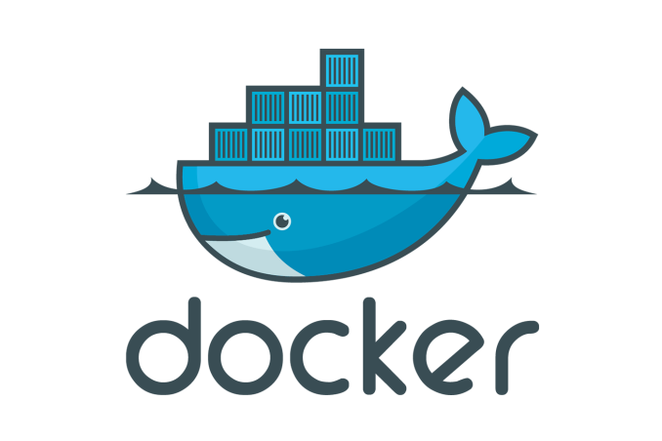

Use case 4: Deploy a war to Tomcat
Goal: Deploy a spring based web application application in Apache Tomcat 8.x
Introduction to Docker for Java Developers

Slide 2


Use case 4: Deploy a war to Tomcat
Spring WAR application
TOMCAT 8.0
Host Operating System (Windows, MAC OSX, Linux)
Docker Engine
Infrastructure / Server
Introduction to Docker for Java Developers

Slide 3
Use case 4: Deploy a war to Tomcat
Summary: We learnt the following commands in DOCKER
COPY : Copies the directory as is to the desired location inside the container.
CMD : First entry point of the container, command to execute on start up. (Refer to use case – 3 where we demonstrate how to execute a jar file).
ADD: Add a directory to the desired location inside the container. (Refer to use case – 3 where we demonstrate how to execute a jar file).
RUN : Execute a command inside the container. (Refer to use case – 3 where we demonstrate how to execute a jar file).
Introduction to Docker for Java Developers

